Slide 1

Trees
From root to leaf

Slide 2
Trees
A tree is a non-linear collection
The elements are in a hierarchical arrangement
The elements are not accessible by 'index'.
Mirrors common concepts
A book : chapters – sections – paragraphs – sentences – words.
Org charts
Folder systems

Slide 3
Terminology
Trees are formed from nodes and edges.
Nodes are also known as vertices
Edges are also known as branches
An edge establishes a relationship between nodes
We denote an edge between nodes A and B as {A, B}
A is the parent of B.
A node can have at most one parent.
Each tree has one root node. The root node is the only node that has no parent.

Slide 4
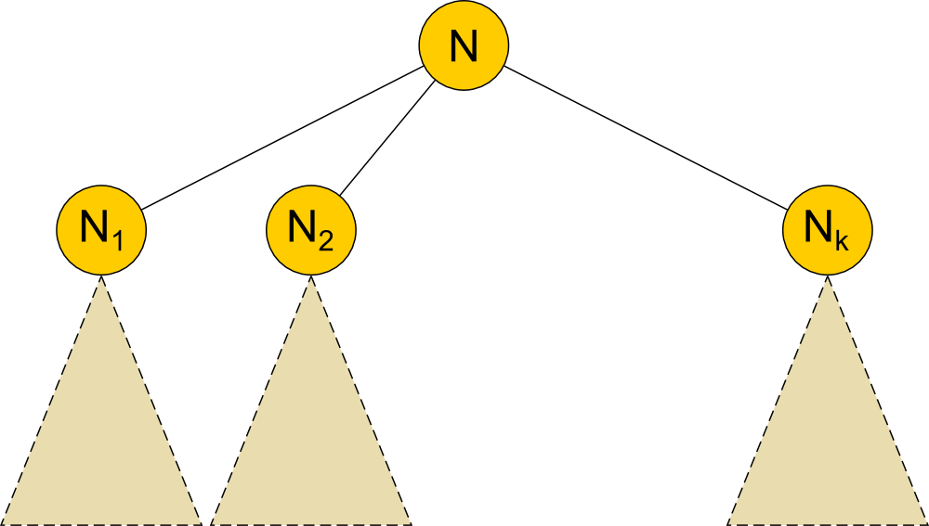
Definitions
Trees can be defined recursively (inductively)
A single node is a tree. It is the root of the tree.
If N is a node and T₁, T₂, …, T_{k} are trees with root nodes N₁, N₂, …, N_{k,} then so is the tree having N as the root and adding edges {N, N₁}, {N, N₂}, …, {N, N_{k}}.
Trees are usually drawn “upside” down. Root at the top.

Slide 5
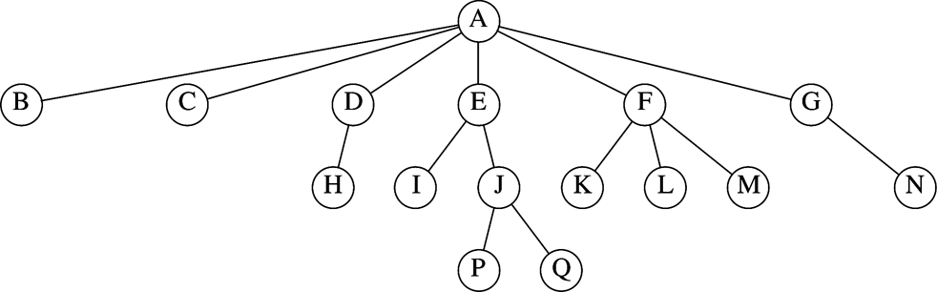
A tree with all nodes and edges shown

Slide 6
Definitions and Terminology
A node is either a leaf node or an internal node
leaf: any node without children
internal: any node with at least one child
The degree of a node is the number of its children
The degree of a tree is the maximum degree of it’s nodes

Slide 7
Definitions and Terminology
A path is a sequence of nodes n₁, n₂, ..., n_{k} such that n_{i} is the parent of n_{i+1} for all 1 ≤ i ≤ k.
The length of the path is he number of edges on the path.
The descendents of a node are all the nodes that are on some path from the node to any leaf.
The ancestors of a node are all the nodes that are on the path from the root to the node.
The siblings of a node are all nodes that have the same parent.
The depth of a node is the length of the path from the root to the node. The depth of a node is also known as its level.
The height of a node is the length of the longest path from the node to any descendent leaf.
The height of a tree is the height of its root.

Slide 8
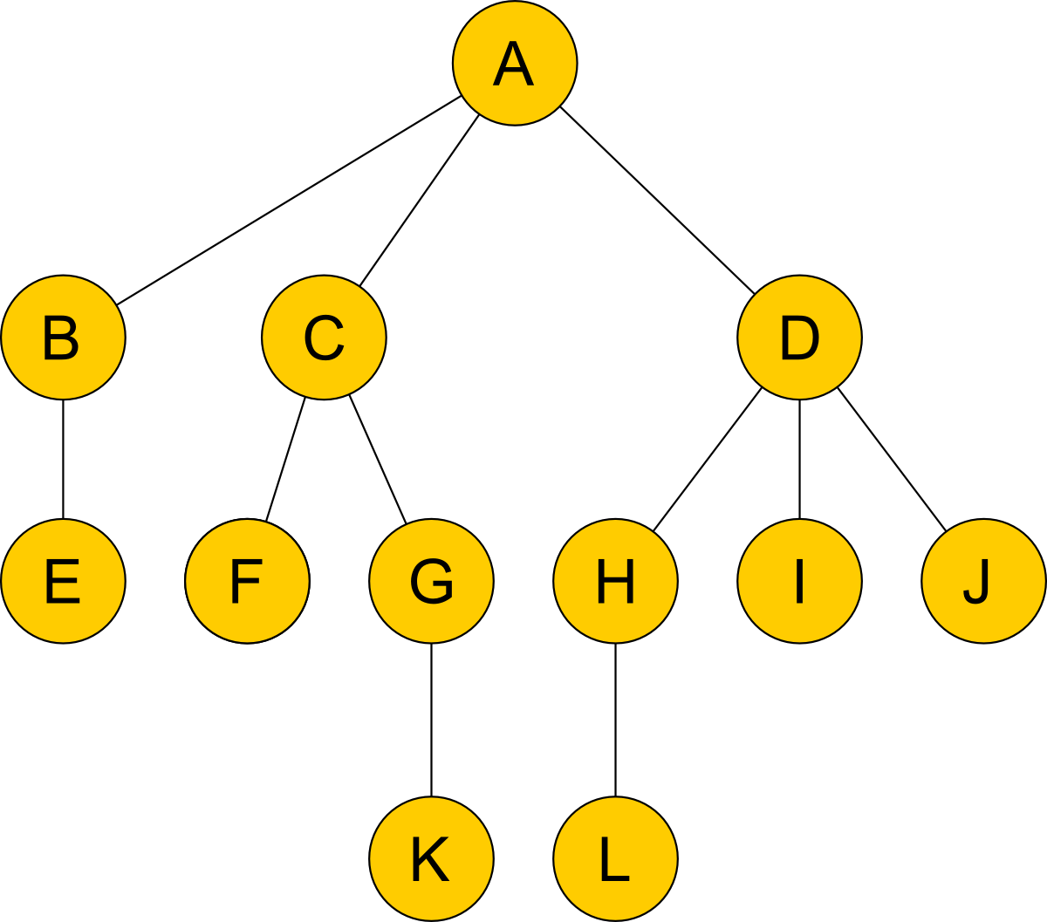
Example
Name the internal nodes.
A,B,C,D,G,H
Name the leaf nodes.
E,F,K,L,I,J
What is the degree of the tree?
3
What is the height of node C?
1
What is the depth of node C?
1
What is the height of the tree?
3
List the descendents of D
H,I,J,L
List the ancestors of D
A
Is C,G,K a path?
Yes
Is A,H,L a path?
No

Slide 9
Binary Trees
A binary tree is a tree where each internal node has degree two (two children). Each child is designated as either the ‘left’ or the ‘right’ child.
Usually, we allow for ‘null’ to be a leaf node in this understanding. Null would be the empty tree.

Slide 10
Tree Traversal
It is often necessary to list the nodes in a binary tree. But how should the nodes be ordered?
There are four common orderings.
pre-order: list the root and then traverse each child in left-to-right order using in-order traversal at each child.
post-order: traverse each child in left-to-right order using post-order traversal at each node. Finally, list the root.
level-order: traverse the nodes in order of their level going left-to-right on each level.
in-order: traverse the left-tree and then list the root and then traverse the right-tree

Slide 11
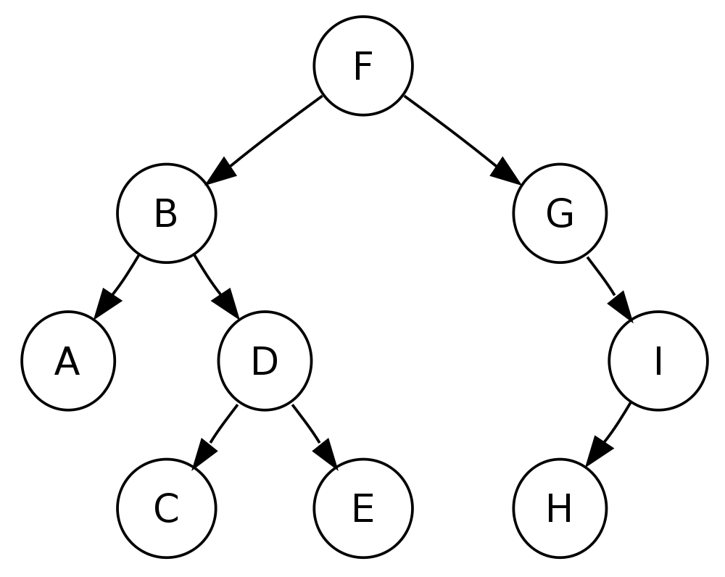
Example
Pre-order traversal:
F, B, A, D, C, E, G, I, H
In-order traversal:
A, B, C, D, E, F, G, H, I
Post-order traversal:
A, C, E, D, B, H, I, G, F
Level-order traversal:
F, B, G, A, D, I, C, E, H

Slide 12
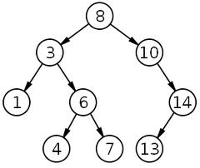
Binary Search Tree
A binary search tree is a binary tree with the following property
Each node is associated with a value or key
For each node in the tree, the nodes key is greater than or equal to all keys in the left subtree and is less than or equal to all keys in the right subtree.

Slide 13
Binary Search Tree Operations
A binary search tree is a collection that supports efficient “searching” along with several other commonly used methods.
boolean contains(T element)
boolean add(T element)
void remove(T element)
E min(E element)
E max(E element)

Slide 14
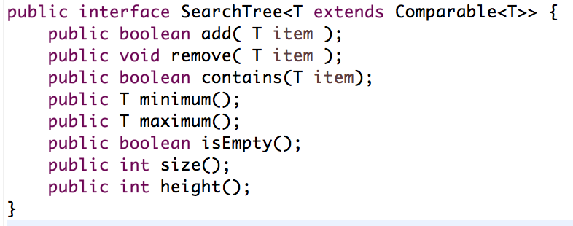
Example interface

Slide 15
Adding and Removing
Describe an algorithm for adding a key to a binary search tree.
Describe an algorithm for finding the minimum key in a binary search tree.
Describe an algorithm for finding the maximum key in a binary search tree.
Describe an algorithm for finding a key in a binary search tree.
Describe an algorithm for removing a key from a binary search tree.
Can binary search tree’s have duplicate keys?

Slide 16
Algorithms
Node Insert(E value, Node n) :
if( n == null) return new Node(value)
else if value < n.value
n.left = insert(e, n.left)
else if value > n.value
n.right = insert(e, n.right)
return n
Node delete(E value, Node n) :
if( n == null) return null
else if value < n.value
n.left = delete(e, n.left)
else if value > n.value
n.right = delete(e, n.right)
else
if n is a leaf then n = null
else if n has one child then n = that child
else
n.value = findMin(n.right) .value
n.right = delete(n.value, n.right)
return n

Slide 17
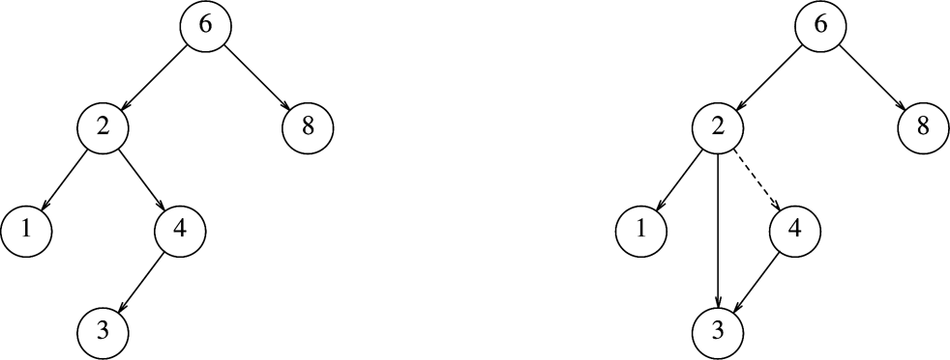
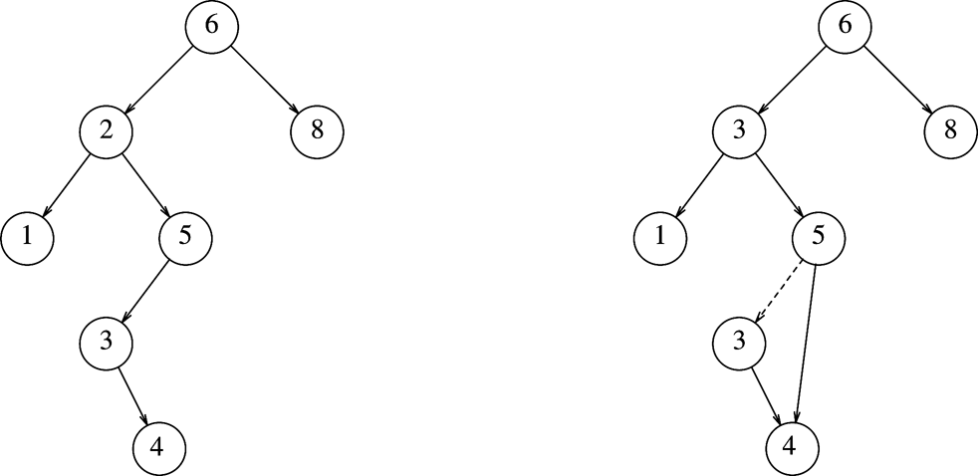
Removing an element from BST
remove 4
remove 2

